Slide 1
Predicting Customer Response To Bank Marketing Campaigns Using Machine Learning
Name: Sourav Khot
PRN: 22070243027

Slide 2

Introduction:-
Data set name:
Bank Marketing
Source:
Kaggle datasets

Slide 3
Problem statement
To predict whether the customer will subscribe or not for a term deposit. It’s either in type yes or no.

Slide 4
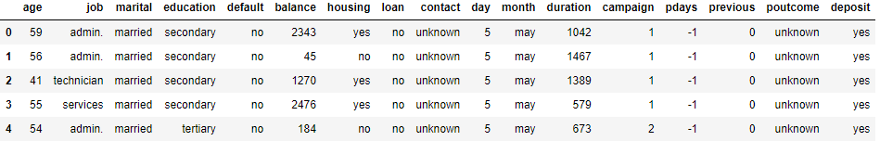
Dataset Details
Dataset shape: 11162 X 17
Data Sample:

Slide 5
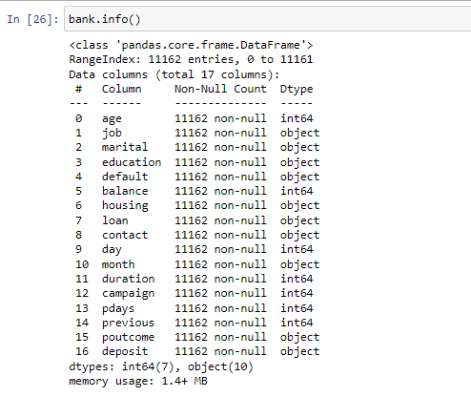
Dataset Details
Data types
There are 7 features of int64 datatype
And there are 10 features of object datatype.

Slide 6
Connection using Psycopg2
Made a connection to the database with the help of the psycopg2 library.
Imported the CSV file into the database for improved storage and more security and accessibility.
Created cursor to perform the operations.
Fetched the file into a data frame using Pandas library for further processing and analysis.

Slide 7
Libraries used:
Pandas
Numpy
Matplotlib
Seaborn
Psycopg2
Plotly
Sci-kit learn
Ipython.display

Slide 8
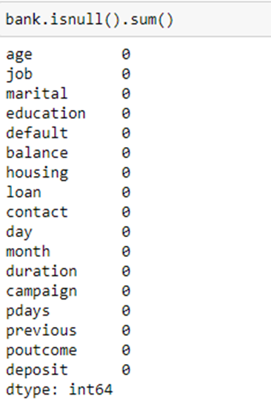
Preprocessing
There are no missing values found in the data
Also for understanding correlation, we find heatmap using seaborn.
Also for converting categorical data to numeric data used label encoding.

Slide 9

Models description:
By data predicted variable is in categorical manner, it is not in continuous that’s why regression is not performed for that classification done where customer interested to subscribe term deposit or not
Feature selection for training and testing
Accuracy of models:
Logistic regression accuracy :- 74.76%

Slide 10
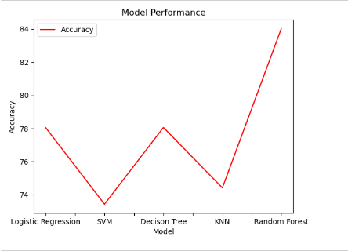
Accuracy of Models:-
Decision tree accuracy:- 78.05%
Random Forest: accuracy:- 84.02%
Support vector Machine(SVM) accuracy:- 73.42%
KNN classifier accuracy:- 74.41%
Graphically showing the difference
between different models.

Slide 11
Thank you !

